Slide 1
Computing for population densities in Cities and Barangays
Amon, Mark Resty
Asejo, Alvinne
Noguera, Renee Mary Laica
Sultan, Jeffrey Taylor
Ty, John Kerwin

Slide 2

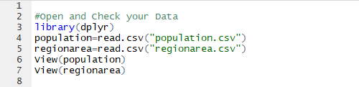


TOP 5 Barangay in terms of Population Density
Open population.csv and regionarea.csv in R Studio and Check the Values
Determine Number of Barangay Per Region (d.f=Count)
Merge the data frames (Count and RegionArea,Data Frame = Mer)
4) Add new Column in Mer, for computing Area for Each Barangay. (Area/#Barangay in Region)
5) Create smaller data frame with Region and area/barangay (d.f=Edited)

Slide 3
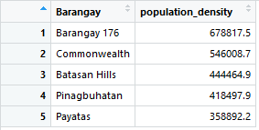


TOP 5 Barangay in terms of Population Density
6) Merge Edited and population.
7) Create New Column that shows Population Density, Population/AreaperBarangay
8) Create smaller Data frame by selecting Barangay and Population Density
9) Arrange and Slice the data frame to shot the top 5

Slide 5
Population Density = Total Population of Area / Total Area
Count provinces per region
Merge City and Area
Group Population by Region then by City
Area of City in Region = Area of Region /Number of Cities in Region
Total Population per City = sum (Population)

Slide 6
TOP 5 Cities in terms of Population Density
# read the csv files
population <-read.csv("population.csv")
regionarea <-read.csv("regionarea.csv")
# load the dplyr package
library(dplyr)

Slide 7
TOP 5 Cities in terms of Population Density
# count the number of cityprovinces by region
by_city=group_by(population,Region)
nocity=summarise(by_city,n_distinct(CityProvince))
# merge two data frames by Region
merged <- merge(nocity,regionarea,by="Region")
# computed for the total area per region divided by number of cities
areapercity = mutate(merged,merged$Area/merged$`n_distinct(CityProvince)`)

Slide 8
TOP 5 Cities in terms of Population Density
# group by region and city, then get the sum of total population for each city
by_pop = group_by(population,Region,CityProvince)
citypop=summarise(by_pop,sum(Population))
# merges the tables for city population and area per city
finalcitypop<-merge(citypop,areapercity,by="Region")

Slide 9
TOP 5 Cities in terms of Population Density
#renaming the derived columns
colnames(finalcitypop)[3]<-"city_population"
colnames(finalcitypop)[4]<-"no_of_cities_per_region"
colnames(finalcitypop)[5]<-"area_per_region"
colnames(finalcitypop)[6]<-"area_per_city"

Slide 10
TOP 5 Cities in terms of Population Density
# computes for the population density
popdensity=mutate(finalcitypop,`city_population`/`area_per_city`)
View(popdensity)
# renames last column as population density
colnames(popdensity)[7]<-"population_density"

Slide 11
TOP 5 Cities in terms of Population Density
# gets the top 5 highest value
topfive=top_n(popdensity,5)
View(topfive)
# sorts the top 5 in descending order
sorted = arrange(topfive, desc(population_density))
View(sorted)
#writes the csv file of the sorted matrix
write.csv(sorted,file="top5citydensity.csv")

Slide 12
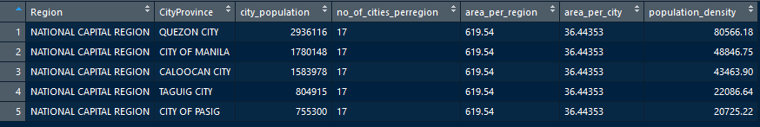
TOP 5 Cities in terms of Population Density

Slide 13
